Slide 1
Finding the Subnet, Broadcast and Useable Host Ranges
Lecture 14
Topic: Medium access control sub layer: ALOHA, Slotted ALOHA

Slide 2
Introduction
Data link control is a mechanism which provides a link with reliable communication.
In the protocols we assumed that there is an available dedicated link (or channel) between the sender and the receiver.
This assumption may or may not be true.
If, indeed, we have a dedicated link then the assumption is true and we do not need anything else.
When nodes or stations are connected to use a common link, called a multipoint or broadcast link, we need a multiple access protocol to coordinate access to the link.

Slide 3
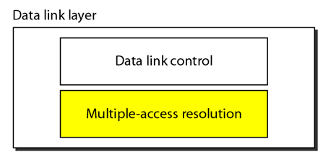
Cont.
We can consider the data link layer as two sublayers.
The upper sublayer is responsible for data link control, and
The lower sublayer is responsible for resolving access to the shared media.
If the channel is dedicated, we do not need the lower sublayer.

Slide 4
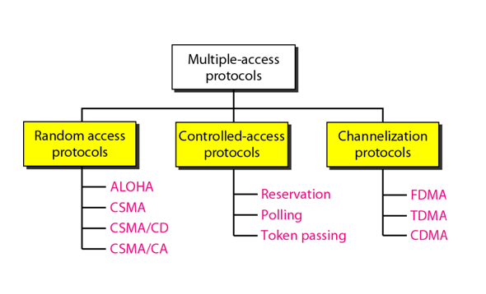
Taxonomy of multiple-access protocols

Slide 5
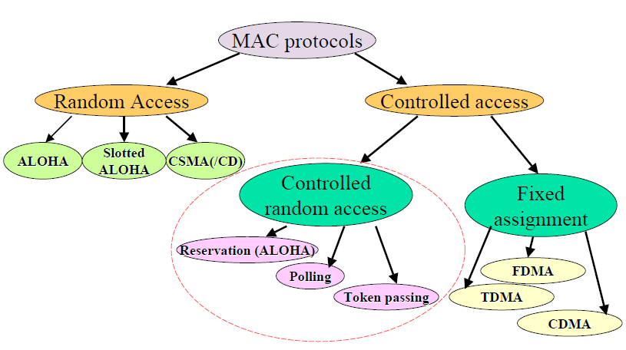
Taxonomy of multiple-access protocols

Slide 6
Random Access
In random access or contention methods, no station is superior to another station and none is assigned the control over another.
No station permits, or does not permit, another station to send.
At each instance, a station that has data to send uses a procedure defined by the protocol to make a decision on whether or not to send.

Slide 7
Cont.
Two features give this method its name.
First, there is no scheduled time for a station to transmit. Transmission is random among the stations. That is why these methods are called random access.
Second, no rules specify which station should send next. Stations compete with one another to access the medium. That is why these methods are also called contention methods.

Slide 8
Cont.
In a random access method, each station has the right to the medium without being controlled by any other station.
However, if more than one station tries to send, there is an access conflict-collision-and the frames will be either destroyed or modified.
To avoid access conflict or to resolve it when it happens, each station follows a procedure that answers the following questions:

Slide 9
Cont.
When can the station access the medium?
What can the station do if the medium is busy?
How can the station determine the success or failure of the transmission?
What can the station do if there is an access conflict?
The random access methods evolved from a very interesting protocol known as ALOHA, which used a very simple procedure called multiple access (MA).

Slide 10
ALOHA
ALOHA, the earliest random access method was developed at the University of Hawaii in early 1970.
It was designed for a radio (wireless) LAN, but it can be used on any shared medium.
It is obvious that there are potential collisions in this arrangement.
The medium is shared between the stations. When a station sends data, another station may attempt to do so at the same time.
The data from the two stations collide and become garbled.

Slide 11
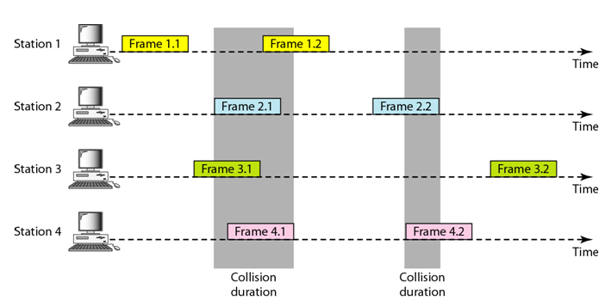
ALOHA-Cont.

Slide 12
ALOHA-Cont.
There are four stations (unrealistic assumption) that contend with one another for access to the shared channel.
In figure each station sends two frames; there are a total of eight frames on the shared medium.
Some of these frames collide because multiple frames are in contention for the shared channel.
Only two frames survive: frame 1.1 from station 1 and frame 3.2 from station 3. We need to mention that even if one bit of a frame coexists on the channel with one bit from another frame, there is a collision and both will be destroyed.

Slide 13
ALOHA-Cont.
There are four stations (unrealistic assumption) that contend with one another for access to the shared channel.
In figure each station sends two frames; there are a total of eight frames on the shared medium.
Some of these frames collide because multiple frames are in contention for the shared channel.

Slide 14
ALOHA-Cont.
Only two frames survive: frame 1.1 from station 1 and frame 3.2 from station 3. We need to mention that even if one bit of a frame coexists on the channel with one bit from another frame, there is a collision and both will be destroyed.

Slide 15
ALOHA-Cont.
It is obvious that we need to resend the frames that have been destroyed during transmission.
The pure ALOHA protocol relies on acknowledgments from the receiver.
When a station sends a frame, it expects the receiver to send an acknowledgment.

Slide 16
ALOHA-Cont.
If the acknowledgment does not arrive after a time-out period, the station assumes that the frame (or the acknowledgment) has been destroyed and resends the frame.
A collision involves two or more stations. If all these stations try to resend their frames after the time-out, the frames will collide again.

Slide 17
ALOHA-Cont.
Pure ALOHA dictates that when the time-out period passes, each station waits a random amount of time before resending its frame.
The randomness will help avoid more collisions. We call this time the back-off time T_{B}.
Pure ALOHA has a second method to prevent congesting the channel with retransmitted frames.
After a maximum number of retransmission attempts K_{max} a station must give up and try later.

Slide 18
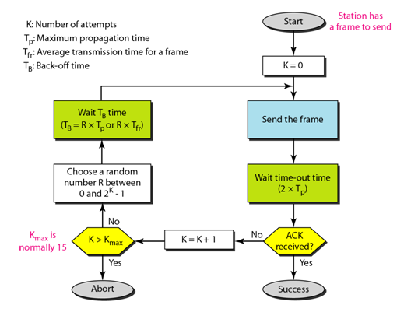
ALOHA-Cont.

Slide 19
ALOHA-Cont.
The time-out period is equal to the maximum possible round-trip propagation delay, which is twice the amount of time required to send a frame between the two most widely separated stations (2 x T_{p}).
The back-off time T_{B} is a random value that normally depends on K (the number of attempted unsuccessful transmissions).
The formula for T_{B} depends on the implementation.

Slide 20
ALOHA-Cont.
One common formula is the binary exponential back-off. In this method, for each retransmission, a multiplier in the range 0 to 2K - 1 is randomly chosen and multiplied by Tp (maximum propagation time) or T_{fr} (the average time required to send out a frame) to find T_{B.}
Note that in this procedure, the range of the random numbers increases after each collision.
The value of K_{max} is usually chosen as 15.

Slide 21
Example
The stations on a wireless ALOHA network are a maximum of 600 km apart. If we assume that signals propagate at 3 × 10⁸ m/s, we find
T_{p} = (600 × 10 ) / (3 × 10⁸ ) = 2 ms.
Now we can find the value of T_{B} for different values of K.
Solution
For K = 1, the range is {0, 1}. The station needs to generate a random number with a value of 0 or 1. This means that T_{B} is either 0 ms (0 × 2) or 2 ms (1 × 2), based on the outcome of the random variable.

Slide 22
Solution-Cont.
For K = 2, the range is {0, 1, 2, 3}. This means that T_{B} can be 0, 2, 4, or 6 ms, based on the outcome of the random variable.
For K = 3, the range is {0, 1, 2, 3, 4, 5, 6, 7}. This means that T_{B} can be 0, 2, 4, . . . , 14 ms, based on the outcome of the random variable.

Slide 23
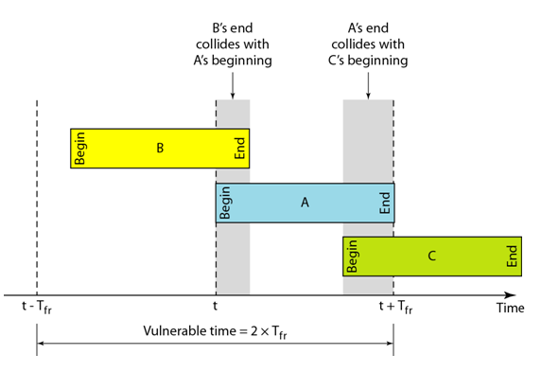
Vulnerable time for pure ALOHA protocol
Let us find the length of time, the vulnerable time that is if frame A is send, under what conditions will the frame arrive intact?
We assume that the stations send fixed-length frames with each frame taking T_{fr} to send.

Slide 24
Cont.
Station A sends a frame at time t. Now imagine station B has already sent a frame between (t - T_{fr}) and t.
This leads to a collision between the frames from station A and station B.
The end of B's frame collides with the beginning of A's frame.

Slide 25
Cont.
On the other hand, suppose that station C sends a frame between t and t + Tfr .
Here, there is a collision between frames from station A and station C. The beginning of C's frame collides with the end of A's frame.

Slide 26
Cont.
Looking at Figure, we see that the vulnerable time, during which a collision may occur in pure ALOHA, is 2 times the frame transmission time.
Pure ALOHA vulnerable time = 2 x Tfr

Slide 27
Example
A pure ALOHA network transmits 200-bit frames on a shared channel of 200 kbps. What is the requirement to make this frame collision-free?
Solution
Average frame transmission time T_{fr} is 200 bits/200 kbps or 1 ms. The vulnerable time is 2 × 1 ms = 2 ms.

Slide 28
Slotted ALOHA
Slotted ALOHA was invented to improve the efficiency of pure ALOHA
In slotted ALOHA we divide the time into slots of T_{fr} and force the station to send only at the beginning of the time slot.
Because a station is allowed to send only at the beginning of the synchronized time slot, if a station misses this moment, it must wait until the beginning of the next time slot.
This means that the station which started at the beginning of this slot has already finished sending its frame.
Of course, there is still the possibility of collision if two stations try to send at the beginning of the same time slot.

Slide 29
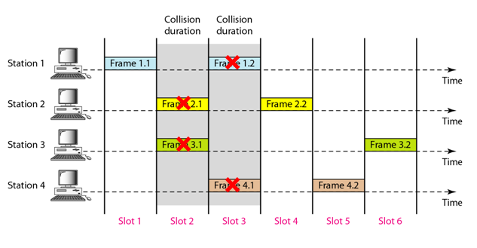
Slotted ALOHA-Cont.
However, the vulnerable time is now reduced to one-half, equal to T_{fr}.
Slotted ALOHA vulnerable time = T_{fr}.

Slide 30
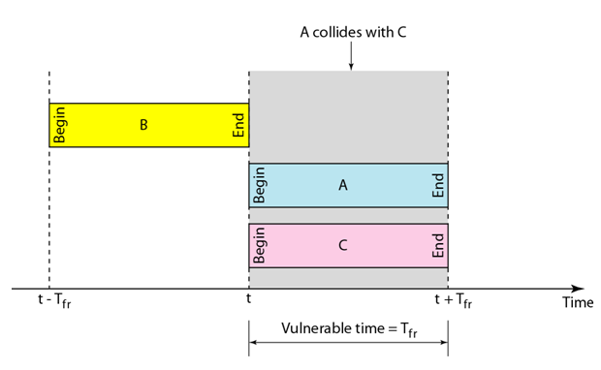
Vulnerable time for slotted ALOHA protocol

